Slide 1
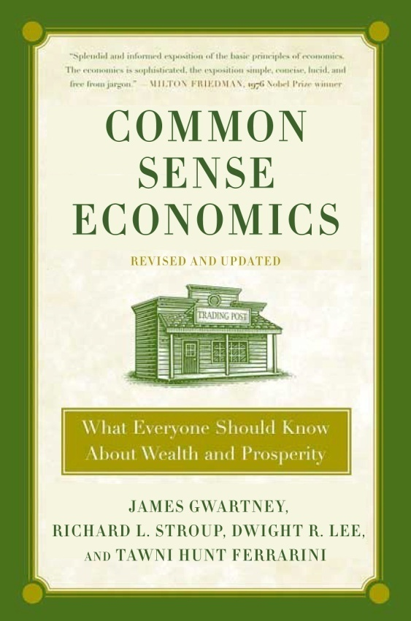
Part 3: Economic Progress and the Role of Government
Common Sense Economics ~ What Everyone Should Know About Wealth and Prosperity
http://CommonSenseEconomics.com/
Turn on the learning light!

Slide 2
Introduction to PowerPoint Slides
The PowerPoint slides for the Common Sense Economics (CSE) electronic package provide an overview of the most important points covered in the text. Students should read the text, watch the assigned videos, and listen to the podcasts prior to reviewing the slides.
The PowerPoint slides are organized by module, which reflects the approximate amount of material most instructors will cover weekly during a regular school term. The 15 core modules cover all of the CSE text. Modules 8, 9, 10, and 11 covering part 3 of CSE are presented here. The slides for each module are organized as follows: (1) module title and list of concepts covered, (2) highlights and explanation of text material, including the CSE elements covered by the module, and (3) questions for thought.
Some instructors may want to use the PowerPoint slides for classroom instruction. The slides will provide students with a comprehensive set of notes and explanatory material for the CSE text.

Slide 3
Part 3 Introduction
Economists use the standard of economic efficiency to assess the operation of an economy.
When resources are used efficiently, only actions that yield more benefits than costs are undertaken.
In part 3, the tools of economics will be used to analyze the operation of both markets and the political process and compare performance with the idealized concept of economic efficiency. We will consider the shortcomings of both.
During the past half century, application of economic tools to the political process has become an integral part of economics. The term Public Choice is used to describe this analysis.

Slide 4
Module 8: Market Failure and the Role of Government
CSE Part 3, Elements 1, 2, and 3
Concepts Covered:
Protective and productive roles of government
Market failure: monopoly
Market failure: externalities
Market failure: public goods

Slide 5
Government And The Economy
Government expenditures are now more than a third of our economy. This highlights why it is important to understand how the political process affects resource allocation.

Slide 6
Element 1. Government promotes economic progress by protecting the rights of individuals and supplying a few goods that are difficult to provide through markets.
A wise and frugal government, which shall restrain men from injuring one another, which shall leave them otherwise free to regulate their own pursuits of industry and improvements, and shall not take from the mouth of labor the bread it has earned. This is the sum of good government.
—Thomas Jefferson

Slide 7
Protective and Productive Functions of Government
Government serves a protective function when it
Creates, upholds and maintains a legal framework.
Protects and enforces the rights of individuals to their person and property.
Government provides a productive function when it
Supplies goods that are difficult to supply efficiently through markets.
National defense and regional flood control projects provide examples.

Slide 8
Element 1. Government promotes economic progress by protecting the rights of individuals and supplying a few goods that are difficult to provide through markets.
A wise and frugal government, which shall restrain men from injuring one another, which shall leave them otherwise free to regulate their own pursuits of industry and improvements, and shall not take from the mouth of labor the bread it has earned. This is the sum of good government.
—Thomas Jefferson

Slide 9
Element 2. When monopoly is present and barriers to entry high, markets will fail to achieve ideal efficiency.

Slide 10
What is Monopoly?
Monopoly: A market characterized by (1) a single seller of a well-defined product for which there are no good substitutes and (2) high barriers to entry.
There are two major sources of monopoly: economies of scale and grants of privilege.
Economies of scale: tendency for a market to be dominated by a single seller because per unit costs decline as firm size increases.
Grant of privilege: government permission required to compete in the market.

Slide 11
Monopoly and Economic Efficiency
Price and Output Under Monopoly
Monopolists have an incentive to restrict output and raise price.
Restricting output and raising price will often increase the revenue of the monopolist.
Inefficiency results because the monopolist fails to produce some units of the good or service that customers value more than their costs.

Slide 12
Monopoly and Government
Anti-Trust action: To promote competition, governments may prohibit actions such as collusion, the merger of dominant firms in an industry, and interlocking ownership of firms. In the U.S. anti-trust laws have performed this function.
The record of government in this area has been mixed. Sometimes government actions (e.g. licensing requirements and discriminatory taxes) have restricted entry into markets, protected existing producers from rivals, and limited price competition.

Slide 13
Element 3. Public goods and externalities result in incentives that may encourage self-interested individuals to undertake activities that are inconsistent with ideal economic efficiency.
The nature of some goods makes them difficult to provide through markets.
Market allocation may result in inefficiency in the case of public goods and externalities.

Slide 14
What is a Public Good?
Public goods have the following two characteristics:
Jointness in consumption: provision of the good to one party simultaneously makes it available to others
Nonexcludability: it is difficult or virtually impossible to exclude non-paying customers.
It is the good’s characteristics, not the sector in which it is produced, that distinguishes it as a public good.
Examples of public goods:
national defense
radio broadcast signal
flood control

Slide 15
Market Failure: Public Goods
Because potential suppliers are unable to establish a one-to-one link between payment for and receipt of the good, it will be difficult to provide public goods through markets.
If a public good is made available to one, it is simultaneously made available to others.
Because those who do not pay can not be excluded, no one has much of an incentive to pay for such goods; each has an incentive to become a free rider.
When a lot of people become free riders, too little of the good is produced.

Slide 16
Externalities: External Costs and Benefits
Externalities exist when the market fails to fully register costs and benefits.
External costs:
Present when the actions of an individual or group harm the property of others without their consent.
The problem arises because property rights are imperfectly defined and/or enforced.
External benefits:
Present when the actions of an individual or group generate benefits for nonparticipating parties.

Slide 17
Market Failure: External Costs
Because some of the costs of production are not fully registered when external costs are present, the supply curve understates the true cost of production.
Units may be produced that are valued less than their true cost.
From the viewpoint of efficiency, market price is too low and too many units are produced.

Slide 18
Market Failure: External Costs
In this market, under initial supply and demand conditions, output Q₁ and price P₁ are present.
If all economic costs were measured and included the supply curve S₂ would result in output Q₂ < Q₁ and price P₂ > P₁.
With external costs, too many units are produced and price is below that which would prevail if all costs were identified and factored into the market process.
Ideal price and output
Price
S₂ (including
external costs)
S₁
P₂
Actual price and output
P₁
D
Q₂
Q₁
Quantity/time

Slide 19
Market Failure: External Benefits
When external benefits are present, the demand curve understates the total value of the output.
Units that are more highly valued than their costs may not be produced.
From the viewpoint of efficiency, too few units may be produced.

Slide 20
Market Failure: External Benefits
In this market, under present supply and demand conditions, output Q₁ and price P₁ are present.
If all benefits were measured and included the new demand curve D₂ would result in output Q₂ > Q₁ and price P₂ > P₁.
With external benefits too few units are produced and price is below that which would prevail if all the benefits were identified and reflected in the market process.
Ideal price and output
Price
S₁
P₂
Actual price and output
P₁
D₂
(including
external benefits)
D₁
Q₁
Q₂
Quantity/time

Slide 21
Implications of Market Failure
Market Failure:
When monopoly, public goods and externalities are present, markets may fail to achieve ideal economic efficiency.
Economists use the term market failure to describe the situation where the existing structure of incentives creates a conflict between personal self-interest and getting the most out of resources.
Market failure creates the potential for government action to improve economic efficiency.
But, the political process is merely an alternative form of economic organization. We need to know more about how that form of organization works so that it can be compared realistically with markets.

Slide 22
Module 8: Questions for Thought
What is a monopoly? Why will monopoly often result in economic inefficiency?
Why are public goods difficult for markets to allocate efficiently?
When external costs are present, how will the price and output of a good compare with that associated with ideal economic efficiency?

Slide 23
Module 9: The Economics of Government Failure
CSE Part 3, Elements 4, 5, and 6
Concepts Covered:
Government failure
Political versus the market process
Special interest and political allocation
Political incentives and short-sightedness

Slide 24
Element 4. Allocation through political voting is fundamentally different than market allocation.
The first lesson of economics is scarcity: there is never enough of anything to fully satisfy all those who want it. The first lesson of politics is to disregard the first lesson of economics.
—Thomas Sowell, Professor of
Economics, Stanford University

Slide 25
The Political Process
The political process is merely an alternative form of social organization.
There are four major differences between the political and market process.
Majority rule provides the basis for government action, while market activity is based on mutual agreement and voluntary exchange.
There is little incentive for voters to search for and acquire information about either issues or candidates because their choices will not be decisive. Economists refer to this as the rational ignorance effect. Thus, individuals will be better informed when making market choices than political choices.

Slide 26
The Political Process continued…
The political process imposes the same option on everyone, while markets allow for diverse representation.
The political process does not have anything like profit and loss that can be counted on to direct resources toward productive, and away from counterproductive, activities.
The modern political process can be viewed as a series of “exchanges” between coalitions and politicians. Concentrated-interest groups provide support (e.g. votes, financial contributions, high-paying jobs) in exchange for spending and regulatory favors. In turn, politicians seek to arrange these exchanges in order to get elected.

Slide 27
Market Failure and Government Failure
Market failure: As explained in the two previous elements, there are cases where markets will fail to allocate resources efficiently.
Government failure: A situation in which the structure of incentives is such that the political process, including democratic political decision-making, will encourage individuals to undertake actions that conflict with economic efficiency.
We now turn to consideration of the analysis of incentives and government failure.

Slide 28
Element 5. Unless restrained by constitutional rules, special interest groups will use the democratic political process to obtain government favors at the expense of others.

Slide 29
Special Interest Issue
Special-interest issue: An issue that generates substantial individual benefits to a small organized minority while imposing a small individual cost on many other voters.
Interest group members feel strongly about issues that provide them with substantial personal benefits. Such issues will dominate their political choices.
In contrast, voters bearing the cost of such legislation often are uninformed on the issue because it exerts only a small impact on their personal welfare and because of the rational ignorance effect.

Slide 30
Government Failure: Special Interest Effect
Special-interest effect: The bias of the political process that encourages politicians to support the views of special interests.
Politicians have a strong incentive to support special interests in exchange for campaign contributions and other forms of political support. This is true even if the action is counterproductive.
Interest group members will decide whom to support primarily on the basis of a politician’s stand on the special interest issue. As the rational ignorance effect illustrates, the bulk of voters will generally be uninformed and disinterested.
Logrolling and pork-barrel legislation strengthen the special interest effect.

Slide 31
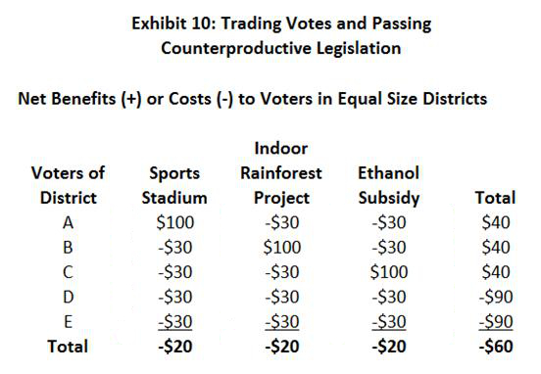
Logrolling and Pork-Barrel Projects Reinforce the Special Interest Effect.
As Exhibit 10 illustrates, projects can be bundled together and obtain majority approval even when each of the projects is counterproductive.

Slide 32
The Special Interest Effect: A “Sweet” Example
The sugar program provides an example of the special interest effect.
Federal price supports and import quotas cause the price of sugar in the U.S to be 50 to 100 percent above the world level.
Approximately 20,000 sugar growers derive huge personal gains at the expense of millions of sugar consumers.
The sugar lobby contributed more than $16 million to legislators and candidates during the most recent election cycle.
The program continues even though Americans are worse off because their resources are wasted producing a good we are ill-suited to produce.

Slide 33
Special Interest Effect, Innovation, and Competition
The special-interest effect tends to stifle innovation and the competitive process.
Politicians will tend to favor established businesses with a stronger record of political contributions and better knowledge of lobbying techniques than newer innovative upstart firms.
The experience of Uber and Tesla provide examples.

Slide 34
Element 6. Unless restrained by constitutional rules, legislators will run budget deficits and spend excessively.
The attractiveness of financing spending by debt issue to the elected politicians should be obvious. Borrowing allows spending to be made that will yield immediate political payoffs without the incurring of any immediate political cost.
—James Buchanan,
1986 Nobel Laureate

Slide 35
Budget Deficits and the National Debt
When government spending exceeds revenues, a deficit will occur.
When the government runs a deficit, it is financed by borrowing, the issuing of Treasury bonds.
The borrowing increases the national debt, the total outstanding bonds on which the government must pay interest.
In contrast, a budget surplus (excess of revenue relative to spending) would reduce the government’s outstanding debt.

Slide 36
Keynesian Revolution and Budget Deficits
Prior to 1960, it was widely believed that the federal government should balance its budget. Except during war, this was pretty much the case.
Keynesians argued that budget deficits should be run when the economy was weak.
The Keynesian view released politicians from a balanced budget constraint.
During 1960-2015 the federal government has run 52 deficits and four surpluses.

Slide 37
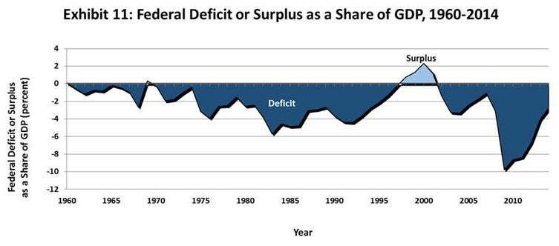
The federal government has run a budget deficit most every year since 1960. Given the political incentive structure, is this surprising? See the following slide.
Source: Office of Management and Budget, President’s Budget *FY 2011 Budget, Table 1.3. http://www.whitehouse.gov/omb/budget/historicals/

Slide 38
Government Failure: The Shortsightedness Effect
Shortsightedness Effect: Issues that yield current, highly visible benefits at the expense of future costs that are difficult to identify.
The political process is biased toward the adoption of such proposals even when they are inefficient.
The shortsightedness effect explains why politicians will find debt financing and unfunded promises attractive—they make it possible for politicians to provide current benefits to voters without levying an equivalent amount of taxes (to pay for them).

Slide 39
Spending Watchdogs
Each member of Congress has a strong incentive to fight hard for expenditures beneficial to his or her constituents.
But, there is little or no incentive for a legislator to be a spending “watchdog”.
Consider the incentives to overspend if every member of Congress decides to go to dinner one night and split the bill by 1/535th. What are the incentives to spend “efficiently” if each member has to pay for each item ordered? How is this altered when each pays 1/535th of the bill?

Slide 40
Shortsightedness Effect and Unfunded Promises
The shortsightedness effect also provides a strong incentive for politicians to support unfunded promises—programs promising benefits that are greater than revenues generated by the tax rates levied for their support.
The federal government has promised senior citizens future payments under the Social Security and Medicare programs that are far greater than the payroll tax revenues that provide their financing.
The debt implied by the unfunded Social Security and Medicare liabilities is almost four times the size of the official national debt.

Slide 41
What Will Happen If the Federal Government Does Not Bring Its Finances Under Control?
There will be repercussions in credit markets (higher interest rates, others will be less willing to lend to the U.S. federal government, etc).
The excessive debt could fuel another financial crisis in the future (consider what has recently happened in Greece).
There will be higher personal and business taxes in the future.
The debt could lead to additional money creation and inflation in the future.

Slide 42
Control of Federal Spending and Borrowing
How can Federal spending and borrowing be controlled? This is unlikely to happen without a change to the political rules. Here are some ideas.
Amend the Constitution to require the federal government to balance its budget annually.
Require a two-thirds or three-fourths approval by both Houses of Congress for spending proposals and increases in the federal government’s borrowing power.
Limit this year’s spending to last year’s level of revenues.

Slide 43
Module 9: Questions for Thought
Carefully define market failure and government failure. How do they relate to idealized economic efficiency?
How does the individual’s incentive to make well informed choices as a consumer compare with their incentive to make well informed choices as a voter?
Why is deficit spending attractive to politicians?
How does the incentive for members of congress to spend on programs beneficial to their district compare to their incentive to control federal spending?

Slide 44
Module 10: The Economics of Taxes and Transfers
CSE Part 3, Elements 7, 8, and 9
Concepts Covered:
Transfers, incentives, and the “welfare” of recipients
Unintended consequences of transfers and subsidies
Central planning, politics, and resource allocation

Slide 45
Element 7. When governments become heavily involved in providing favors to some at the expense of others, inefficiency results and improper, unethical relationships develop between government officials and businesses.
The tool of politics (which frequently becomes its objective) is to extract resources from the general taxpayer with minimum offense and to distribute the proceeds among innumerable claimants in such a way to maximize the support at the polls.
—James R. Schlesinger,
Former Secretary of Defense

Slide 46
Two Ways of Acquiring Wealth
There are two ways of acquiring wealth.
Production:
People can get ahead by producing goods or services of value and exchanging them for income. This method of acquiring income helps the exchanging partners and enhances the wealth of society.
Plunder:
Sometimes people get ahead by “plundering” what others have produced. Plunder not only fails to generate additional income but also consumes resources and thereby reduces the wealth of society.
Governments promote prosperity when they encourage production and discourage plunder.

Slide 47
Impact of Political Favoritism
Subsidies and government favoritism endanger both political democracy and economic efficiency.
Subsidies distort prices and encourage businesses to seek government favors rather than producing better products at a lower cost.
Subsidies to some firms and sectors place other firms at a disadvantage.
Subsidies and favoritism will create an improper, unethical relationship between business and political officials. Businesses will seek government favors in order to enhance profit. Economists call this rent seeking.

Slide 48
Government Failure: Rent Seeking
Rent Seeking: Actions by individuals and interest groups designed to restructure public policy in a manner that will either directly or indirectly transfer income to themselves.
Widespread use of the taxing, spending, and regulatory powers of government that favor some at the expense of others will encourage rent seeking.
Rent seeking diverts resources away from productive activities. The output of economies with substantial amounts of rent seeking will fall below their potential.

Slide 49
Political Favoritism, Crony Capitalism, and Government Failure
As government spending, subsidies, income transfers, and regulatory favors grow, businesses and other well-organized groups will expend more resources seeking to obtain government favors.
As a result, crony capitalism grows relative to market allocation.
Crony capitalism: The situation where the allocation of resources is determined by political favors rather than by consumer preferences translated through the market profit and loss system.

Slide 50
Market Entrepreneurs versus Crony Capitalists
Market entrepreneurs get ahead by providing consumers with products that are more highly valued than the resources required for their production.
Crony capitalists get ahead by providing political players with campaign contributions and other political resources in exchange for government contracts, subsidies, tax benefits, and other forms of political favoritism.
Crony capitalism reflects govt. failure and endangers the legitimacy of the democratic political process.

Slide 51
Element 8. The net gain of transfer recipients is less, and often substantially less, than the amount of the transfer.
To non-economists, income transfers look like an effective way to help targeted beneficiaries.
However, economic analysis indicates that it is actually quite difficult to transfer income to a group of recipients in a way that will improve their long-term well-being.
The unintended secondary effects explain why this proposition is true.

Slide 52
Secondary Effects of Transfers
Three reasons why transfers and subsidies are largely ineffective.
They reduce the incentive of both taxpayer-donors and transfer recipients to earn.
Competition for transfers erodes most of the long-term gain of the intended beneficiaries.
Criterion (e.g. own something, do something, or be something) for receipt of the transfers must be established and competition to meet the criterion will erode net benefits.
Transfer programs reduce the adverse consequences suffered by those who make imprudent decisions, and this reduces their motivation to take steps to avoid the adversity.

Slide 53
Secondary Effects of Transfers
Thinking About the Secondary Effects
When beneficiaries have to do something (for example, wait in line, fill out forms, lobby government officials, take an exam, endure delays, or contribute to selected political campaigns) in order to qualify for a transfer, much of their potential gain will be eroded.
When beneficiaries have to own something in order to get a subsidy, people will bid up the price of the asset needed to acquire the subsidy.
The agriculture subsidy programs, taxi licensing that results in higher prices, and the homestead act provide examples of how secondary effects erode the net gain of transfer recipients.

Slide 54
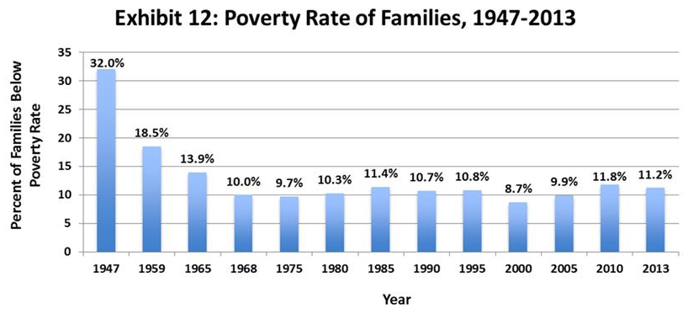
Even though per capita income has more than doubled since the late 1960s, the poverty rate is virtually the same today as when the War on Poverty began.
Source: U.S. Dept. of Commerce, Characteristics of the Population Below the Poverty
Level: 1982, Table 5; and U.S. Census Bureau, Historical Poverty Tables—Families.

Slide 55
Secondary Effects of Anti-Poverty Transfers
Why weren’t the anti-poverty transfer programs more effective? The transfers generate three unintended secondary effects that slow progress against poverty.
The income-linked transfers reduce the incentive of low-income individuals to earn, move up the income ladder, and escape poverty.
High Implicit Marginal Tax Rates: If they earn more, their transfer benefits are reduced and the combination of the additional taxes owed and transfers lost means that they get to keep only 10, 20, or 30 percent of the additional earnings.

Slide 56
Secondary Effects of Anti-Poverty Transfers
Transfer programs that reduce the hardship of poverty also reduce the opportunity cost of risky choices such as dropping out of school or the workforce, childbearing by teenagers and unmarried women, divorce, abandonment of children by fathers, and drug use.
Government antipoverty transfers crowd out private charitable efforts.
When the government does more to help the poor, predictably families, churches, and civic organizations will do less.

Slide 57
Reducing the Likelihood of Poverty
Three things young people can do that will reduce the likelihood of future poverty
Complete high school (at a minimum).
On entering the work force, continue working and seek a full-time job.
Get married before having a child.
The people who choose these three options are unlikely to spend much time in poverty.

Slide 58
Element 9. The economy is far too complex to be centrally planned and efforts to do so will result in inefficiency and cronyism.
The man of system is apt to be very wise to his own conceit. He seems to imagine that he can arrange the different members of a great society with as much ease as the hand arranges the different pieces upon a chess-board.
—Adam Smith (1759), The Theory
of Moral Sentiments

Slide 59
Central Planning and the Fatal Conceit
Central planning replaces markets with government. It can involve direct command and control, as under the old Soviet system. But it can also occur when elected political officials substitute their verdicts for those of consumers, investors, and entrepreneurs directed by market forces.
Economics, however, indicates that central planning will be inefficient. There are five major reasons why this will be the case.

Slide 60
Central Planning and the Fatal Conceit
Central planning merely substitutes politics for market decisions.
Subsidies and investment funds disbursed by governmental planners are influenced by political rather than economic considerations.
“Old” firms tend to be favored over “new”, growth-oriented firms.
“Pork-barrel” projects will be pursued.

Slide 61
Central Planning and the Fatal Conceit
The incentive of government-operated firms to keep costs low, be innovative, and efficiently supply goods is weak.
Managers of government firms gain little from improved efficiency and lower costs.
Central planners spending the money of taxpayers will invest less wisely than investors risking their own money.
Private investors bear the consequences of poor investments directly. In contrast, the success or failure of government projects seldom affects the personal wealth of government planners.

Slide 62
Central Planning and the Fatal Conceit
The efficiency of government spending will also be undermined because the budget of an unconstrained government is something like a common pool resource.
When money and resources are owned in common, there is little motivation to consider the future.
This common resource characteristic explains why, when interest groups are pursuing government spending, they have little incentive to consider either the future or the adverse impact of their actions.
In their view, if they do not grab more of the government budget some other interest group will.

Slide 63
Central Planning and the Fatal Conceit
There is no way that central planners can acquire enough information to create, maintain, and constantly update a plan that makes sense.
Markets channel information to both producers and consumers via the price system.
Market profit and loss disciplines individuals and holds them accountable for constantly retrieving, maintaining and updating present and future plans based on efficiency, not political considerations.
The political process does not have anything like profit and loss that will persistently channel resources into productive projects.

Slide 64
Module 10: Questions for Thought
What are the two ways of acquiring wealth? From the viewpoint of the society, does it make any difference which of the two methods is used most extensively? Explain.
In recent years, the grant and subsidized loan programs directed toward college students have expanded substantially. Have these programs enhanced the well-being of college students? Why or why not?

Slide 65
Module 10: Questions for Thought
Is there reason to believe that elected officials and government experts will do a better job of allocating resources than profit seeking business entrepreneurs? Why or why not?

Slide 66
Module 11: Federalism and Constitutional Structure
CSE Part 3, Element 10 and concluding thoughts on constitutional rules
Concepts Covered:
Competition among governments, incentives, and resource allocation
Constitutional rules and sound economics

Slide 67
Element 10. Competition is just as important in government as in markets.
Decentralization allows people to move toward governmental units that provide desired public services at a low cost.
In turn, the movements of voters will discipline governments and help keep them in line with the preferences of citizens.

Slide 68
Competition and the Performance of Government
Competition is a disciplinary force. In the market sector, it weeds out inefficiency and provides a strong incentive for firms to serve consumers.
Competition among decentralized governmental units can also improve the performance of government.
Efficiency will be improved when private firms are given the opportunity to compete with government enterprises. Vehicle maintenance, printing shops, postal services, garbage collection, street maintenance, and schools provide examples where this is feasible.

Slide 69
Competition and the Performance of Government continued…
Competition among decentralized government units will provide each with an incentive to operate more efficiently. If a government levies high taxes (without providing a parallel quality of service) and regulates excessively, some individuals and businesses that make up their tax base will choose the exit option.
With decentralization, citizens will be able to group together with others desiring similar combinations of government services and taxes, and this grouping will make it possible for more people to obtain services consistent with their preferences.

Slide 70
Competition and Structure of Government
If competition is going to serve the interests of citizens, it must not be stifled by the federal government.
When the national government subsidizes, mandates, and regulates the bundle of services provided by state and local governments, it undermines the competitive process among them.
Competition among governments will not evolve automatically. It will have to be incorporated into the political structure.

Slide 71
Thinking About Constitutional Rules For Prosperity
There is enormous inertia—a tyranny of the status quo—in private and especially government arrangements. Only a crisis—actual or perceived—produces real change. When that crisis occurs, the actions that are taken depend on the ideas that are lying around. That, I believe, is our basic function: to develop alternatives to existing policies, to keep them alive and available until the politically impossible becomes politically inevitable.
—Milton Friedman,
1976 Nobel Laureate

Slide 72
Constitutional Design for Prosperity
What would a constitution designed to promote economic freedom and prosperity look like?
If government is going to be a positive force for economic prosperity, the rules of the political game must bring the self-interest of voters, politicians, and bureaucrats into harmony with economic progress.
Limited government, equal treatment under the law, protection of property rights, and federalism are cornerstones of a sound constitution.
When a government supports private ownership, freedom of exchange, competitive markets, the rule of law, and monetary stability, it will provide the environment for economic growth and prosperity.

Slide 73
What Would a Constitution Designed to Promote Economic Freedom and Prosperity Look Like?
Promoting government action based on agreement rather than coercion is important.
People will agree to an action only when each party gains. Thus, actions based on agreement, whether undertaken through markets or government, will be mutually advantageous and will therefore promote the general welfare rather than the interests of some parties at the expense of others.
The challenge before us is to restore the intent of the constitutional rules and to develop a few new ones that will promote government action based on agreement and bring the political process back into harmony with economic progress.

Slide 74
Module 11: Questions for Thought
Does competition among governmental units improve its responsiveness to the views of citizens? Explain.
Did the framers of the U.S. Constitution get the general structure of government correct? Was the design supportive of political action based on agreement?
Evaluate the proposed nine constitutional reforms suggested by the authors. Indicate why you would agree or disagree with each of the reforms.

