Slide 1
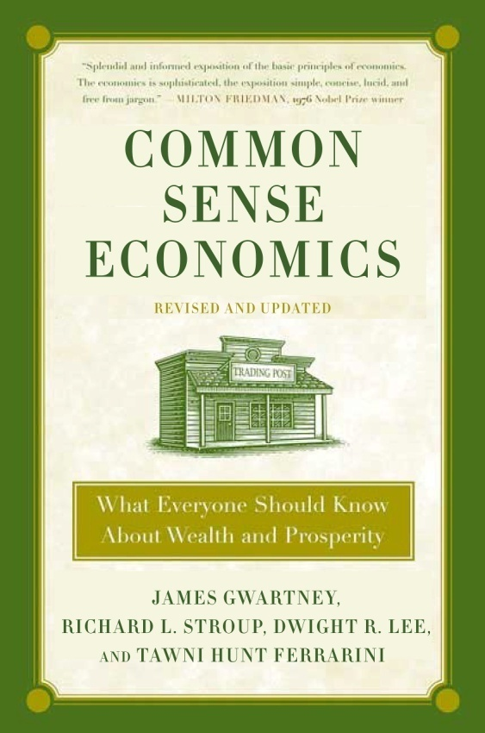
Part 2: Seven Major Sources of Economic Progress
Common Sense Economics ~ What Everyone Should Know About Wealth and Prosperity
http://CommonSenseEconomics.com/
Turn on the learning light!

Slide 2
Introduction to PowerPoint Slides
The PowerPoint slides for the Common Sense Economics (CSE) electronic package provide an overview of the most important points covered in the text. Students should read the text, watch the assigned videos, and listen to the podcasts prior to reviewing the slides.
The PowerPoint slides are organized by module, which reflects the approximate amount of material most instructors will cover weekly during a regular school term. The 15 core modules cover all of the CSE text. Modules 5, 6, and 7 covering part 2 of CSE are presented here. The slides for each module are organized as follows: (1) module title and list of concepts covered, (2) highlights and explanation of text material, including the CSE elements covered by the module, and (3) questions for thought.
Some instructors may want to use the PowerPoint slides for classroom instruction. The slides will provide students with a comprehensive set of notes and explanatory material for the CSE text.

Slide 3
Module 5: Property Rights and the Competitive Process
CSE Part 2, Elements 1 and 2
Concepts Covered:
Economic growth: record and importance
Legal system and private ownership
Private property and incentives
Competitive process

Slide 4
Why Is Economic Growth Important?
Robert Lucas, the 1995 Nobel laureate, stated, “Once you start thinking about economic growth, it is hard to think about anything else.”
Why do economists place so much emphasis on economic growth? Answer: Growth of real output is necessary for the growth of real income. Without growth, higher income levels and living standards cannot be achieved.
Throughout most of human history, economic growth has been extremely rare, but this began to change around 1800.

Slide 5
Per Capita Income: The last 1000 years
Per capita income changed very little for centuries prior to 1800, but growth has exploded during the last 200 years.
(Measured in 1990 dollars) world per capita income was $667 in 1820—only about 50% higher than year 1000. By 2003, however, income had risen to $6,516—10 times the 1820 level.
During the past 200 years, the income growth of the high-income industrial countries (west) has been even higher–nearly 20 fold.
$25,000
GDP Per Capita (1990 dollars)
2003: $23,710
$20,000
West GDP per capita
$15,000
2003: $6,516
$10,000
World GDP per capita
1820: $1,202
$5,000
1820: $667
1000
1100
1200
1300
1400
1500
1600
1700
1800
5
1900
2003
Source: Angus Maddison, Contours of the World Economy, 1-2030AD: Essays
in Macro-Economic History (Oxford: Oxford University Press, 2007)

Slide 6
Life Expectancy: The last 1000 years
The pattern of life expectancy is similar to that of per capita income.
Life expectancy at birth for the world rose from 24 to 26 years between 1000 and 1820, but it soared to 64 by 2003.
Life expectancy in the high-income industrial countries (West) followed a similar pattern.
Life Expectancy (at birth)
80
70
2003: 76
60
2003: 64
50
1820: 36
40
West life expectancy
30
20
World life expectancy
1820: 26
10
1000
1100
1200
1300
1400
1500
1600
1700
1800
1900
2003
Source: Angus Maddison, Contours of the World Economy, 1-2030AD: Essays
in Macro-Economic History (Oxford: Oxford University Press, 2007)

Slide 7
Element 1. Legal System: The foundation for economic progress is a legal system that protects privately owned property and enforces contracts in an evenhanded manner.
[A] private property regime makes people responsible for their own actions in the realm of material goods. Such a system therefore ensures that people experience the consequences of their own acts.
—Tom Bethell, Economic Journalist

Slide 8
Private Property Rights
Private ownership of property involves three things:
Exclusive use: Owners of private property can decide how their property will be used.
Protection against invaders: Others are prohibited from using the property without the owners permission.
Transferability: Owners have the right to buy, sell, or derive income from their land, natural resources, capital, and entrepreneurial talent.
Private ownership makes people accountable for their actions.

Slide 9
Private Ownership and Incentives
The most important aspect of private ownership is the incentives it creates. There are four major reasons why private ownership propels economic growth and progress. Private ownership:
provides people with a strong incentive to maintain and care for their property.
encourages people to use and develop their property in ways others value highly.
makes owners legally responsible for damages imposed on others as the result of how their property is used.
promotes the conservation of resources for the future.

Slide 10
Private Ownership and Doomsday Forecasts
For centuries pessimists have argued that the world is about to run out of various critical resources (e.g. trees, minerals, and energy sources). Why have they been wrong?
When the scarcity of a privately owned resource increases, the invisible hand of the market takes over and prices rise.

Slide 11
Private Ownership and Doomsday Forecasts continued…
The increase in price provides consumers, producers, innovators, and engineers with incentives to
conserve on the direct use of the resource,
search more diligently for substitutes, and
develop new methods of discovering and recovering larger amounts of the resource.
To date these forces have pushed doomsday ever farther into the future, and there is every reason to believe that they will continue to do so for resources that are privately owned.

Slide 12
Legal System and Private Ownership
A legal system that protects property rights and enforces contracts in an evenhanded manner provides the foundation for gains from trade, capital formation, and resource development, which comprise the mainsprings of economic growth.
Other forms of ownership have been tried. However, none provide as much freedom and incentive to serve others and use resources efficiently as private ownership within the framework of the rule of law.

Slide 13
Element 2. Competitive Markets: Competition promotes the efficient use of resources and provides the incentive for innovative improvements.
Competition is conducive to the continuous improvements of industrial efficiency. It leads producers to eliminate wastes and cut costs so that they may undersell others. It weeds out those whose costs remain high and thus operates to concentrate production in the hands of those whose costs are low .
—Clair Wilcox, Former Professor
of Economics, Swarthmore College

Slide 14
The Competitive Process
Competition is present when the market is open and alternative firms are free to enter and compete.
Competition encourages firms to:
supply goods and services consumers value highly relative to cost and
produce efficiently (keep their costs low).
Competition weeds out firms that fail to provide consumers with quality goods at competitive prices.

Slide 15
Consumers Rule!
Consumers Vote on Which Businesses Stay and Which Must Go Using Their Dollars.
Consumer purchases translate into business revenue.
Producers will supply those goods and services consumers value enough to pay a price sufficient to cover the cost of the resources required for their production.
Producers who fail to do this will make losses and be driven out of business. Profits and losses decide which firms will survive and what goods will be produced.

Slide 16
Competition and Innovation
In a market economy entrepreneurs are free to innovate. They need only the support of investors (often including themselves) willing to put up the necessary funds.
If consumers value the innovation enough to cover its costs, the new business will profit and prosper.
But if consumers find that the new products are worth less than their costs, the businesses will suffer losses and eventually fail.
Consumers are the ultimate judge and jury of business innovation and performance.

Slide 17
Competition, Business Structure, and Size of Firm
Competition discovers the business structure and size of firm that can best keep the per-unit cost of a product or service low.
Business structure:
Unlike other economic systems, a market economy does not mandate the types of firms that are permitted to compete.
Size of firm:
In some sectors—the manufacturing of airplanes and automobiles, for example—firms will need to be quite large to take full advantage of economies of scale.
In other sectors, however, small firms will be more cost-effective. When consumers place a high value on personalized service small firms generally dominate.

Slide 18
Competition, Business, and Government
Competition is not pro-business.
Businesses often lobby government officials requesting favors that will limit competition.
Government regulations that limit entry into markets and favor some businesses over others undermine the competitive process.

Slide 19
Self-interest and Competition
When Directed by Competition, Self-Interest is a Powerful Force for Economic Progress.
It is not from the benevolence of the butcher, the brewer, or the baker that we expect our dinner, but from their regard to their own self-interest. We address ourselves not to their humanity but to their self-love, and never talk to them of our own necessities, but of their advantages.
—Adam Smith, Wealth of Nations, 1776

Slide 20
Module 5: Questions for Thought
Does private ownership entitle the owners to do anything they want with their property? Why or why not?
What would happen to the size of the cattle population if Americans decided to eat substantially less beef? Explain the logic underlying your answer.

Slide 21
Module 5: Questions for Thought
“The quantity of non-renewable resources such as oil, natural gas, copper, and iron ore is fixed. Unless we begin to reduce our consumption of these and other minerals, we will soon run out of them.” Is this true? Explain.
In a competitive market, what must a firm do in order to be successful? What happens to firms that fail to provide consumers with desired goods at prices equal to or less than those available from other firms? Is this good or bad?

Slide 22
Module 6: Regulation, Capital Markets, and Monetary Stability
CSE Part 2, Elements 3, 4, and 5
Concepts Covered:
Regulation and gains from trade
Capital markets: wealth-creating versus inefficient projects
Monetary policy and inflation

Slide 23
Element 3. Limits on Government Regulation: Regulatory policies that reduce exchange and restrict competition impede economic progress.
Exchange is productive; it helps people expand output and achieve higher income levels.
Competition is the source of market discipline. Regulations requiring entrants to obtain permission from the government are generally counterproductive.
A country cannot realize its full potential unless restrictions that limit trade and reduce competitiveness are kept to a minimum.

Slide 24
Regulation, Exchange, Competitiveness of Markets
Governments limit exchange and reduce the competitiveness of markets when they:
limit entry into businesses and occupations. Licensing requirements, completing bureaucratic forms, and other political roadblocks reduce the competitiveness of markets.
substitute political authority for the rule of law and freedom of contract. Imprecise, ambiguous and discriminatory laws invite people to spend resources on lobbying and searching for political favoritism rather than production.
impose price controls. Price floors and ceilings interfere with trades between buyers and sellers, distort prices, and lead to inefficient levels of production and employment.

Slide 25
Economics of the Minimum Wage
The basic postulate of economics indicates that a higher minimum wage will reduce the employment of low-skill workers.
Research indicates that each 10 percent increase in the minimum wage will reduce employment by between 1 and 2 percent.
Because the wage increases are substantially larger than the reductions in employment, a higher minimum wage will nearly always increase the total earnings of low-skill workers.
Proponents of minimum wages believe that the higher total earnings are worth the reductions in employment.

Slide 26
Minimum Wage and Poverty
It appears that a higher minimum wage would reduce poverty, but this view is questionable.
About 80 percent of minimum wage workers are members of households with incomes above the poverty level. Only one out of every seven is the primary earner for a family with one or more children.
Secondary effects: the higher minimum wage will result in less hours worked, fewer training opportunities, a less convenient work schedule, and fewer fringe benefits.
More than half of the poor families in the U.S. do not have anyone in the labor force, and therefore a higher minimum wage will not help them.

Slide 27
Occupational Licensing in the United States
Most occupational licensing occurs at the state level.
In order to obtain a license, one has to pay fees ranging from modest to exorbitant, take training courses for 6 to 12 months, and pass examinations.
Licensing requirements have increased substantially in recent decades.
In 1970, fewer than 15 percent of Americans worked in jobs that required a license. Today, the figure is nearly 30 percent, and it is continuing to grow.
Today more more than 1,100 occupations are licensed in at least one state, up from 800 in the 1980s.

Slide 28
Occupational Licensing in the United States continued…
Occupational licensing requirements prohibit individuals from pursuing desired careers.
Licensing reduces supply and drives up the price of the goods and services provided by the licensed practitioners.
Those currently in the occupation gain at the expense of consumers and unlicensed potential producers.
The employment opportunities of the unlicensed producers are diminished and potential gains from trade lost.

Slide 29
Regulations and Economic Progress
Regulations often appear to be an easy way to solve problems. But, regulatory policies often reduce gains from trade, production and the competitiveness of markets.
Regulatory policies that impose roadblocks against trade and entry into markets will almost always be counterproductive.

Slide 30
Element 4. An Efficient Capital Market: To Realize Its Potential, a Nation Must Have a Mechanism that Channels Capital into Wealth-Creating Projects.
If a country is going to grow and prosper, a mechanism is needed to channel savings into productive investments.
Capital markets perform this function. They:
attract savings and channel it into investments expected to generate wealth.
bring millions of buyers and sellers in various types of markets together.

Slide 31
Capital Investment and Its Role in Growth
Capital goods are assets that will help us produce more consumption goods in the future.
Investment requires the sacrifice of current consumption in order to expand future output and consumption.

Slide 32
Sound Institutions Matter.
Sound institutions protect the rights of the buyers and sellers and enforce the rules and regulations against fraud and misrepresentation.
Capital markets, broadly defined, include both personal and business loans.
Banks, credit unions and investment firms are part of the capital market. They bring the buyers and sellers of capital together as savers, borrowers and investors.

Slide 33
Investments: Productive and Unproductive
Productive investments will yield returns sufficient to cover all costs, including borrowing and the opportunity cost of funds invested.
Not all investment projects are productive. Investment involves risk. Unprofitable and unproductive investments will occur in a world of uncertainty.
Failures play an important role. Losses will lead to business failure and bring unproductive investments to a halt.

Slide 34
Investments: Productive and Unproductive continued…
Market forces hold investors accountable for their mistakes. This provides them with a strong incentive to search for and undertake productive projects and avoid ones that are unproductive.
Technology and innovation are also important sources of growth. In a world of uncertainty, mistaken investments are a necessary price that must be paid for fruitful innovations in new technologies and products. If we are going to get the most out of our resources, it must be easy to try out innovative new ideas, but difficult to continue with them if they are counter productive.

Slide 35
Political Allocation of Investment
When investment funds are allocated by the government, rather than by the market, an entirely different set of factors comes into play.
Political influence rather than market returns will determine which projects will be undertaken.
Investment projects that reduce rather than create wealth will become more likely.
The experiences of the centrally planned economies illustrate this point.
The investment rates in these countries were among the highest in the world. But, political, rather than economic considerations, determined which projects would be funded. These economies eventually collapsed due to poor economic performance.

Slide 36
Politics in the U.S. Mortgage Market
Political considerations have influenced the U.S. mortgage market.
Two large government-sponsored corporations, Fannie Mae and Freddie Mac, played an important role in the allocation of financial capital to the housing industry.
Fannie Mae and Freddie Mac had a competitive advantage because they were able to obtain funds cheaper than private firms since their bonds were perceived to be backed by the federal government.
During 1999-2005 Fannie Mae and Freddie Mac held more than 40 percent of all home mortgages.

Slide 37
Politics in the U.S. Mortgage Market continued…
In the mid-1990s, the Department of Housing and Urban Development mandated that, by 1996, 40 percent of the mortgages financed by Fannie Mae and Freddie Mac must go to households with incomes below the median. This figure was increased to 50 percent by 2000 and to 56 percent by 2008.
In order to meet these mandates, Fannie and Freddie
began accepting more mortgages with little or no down payment.
substantially increased their mortgages to sub-prime borrowers, those with a poor credit history.

Slide 38
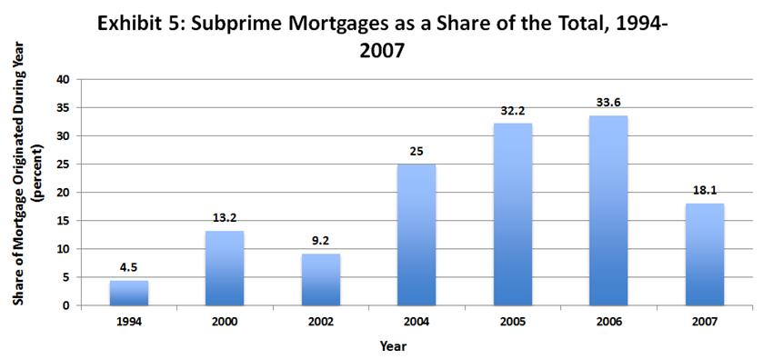
In order meet the HUD mandates, Fannie and Freddie reduced lending standards and extended more loans to sub-prime borrowers.
Sub-prime mortgages soared from 4.5 percent of the new mortgages in 1994, to 13.2 percent in 2000 and 32 percent in 2005-2006.
Source: The 1994-2000 data are from Edward M. Gramlich, Financial Services Roundtable Annual Housing Policy Meeting, Chicago, Illinois,
21 May 2004. The 2002-2007 data are from the Joint Center for Housing Studies of Harvard University, The State of the Nations Housing 2008.

Slide 39
Secondary Effects of Mortgage Market Regulations
The impact of declining lending standards:
Initially, the lower lending standards led to an increase in demand for, and price of, housing.
But, the artificially created housing boom was not sustainable. As soon as prices leveled off and then began to decline during the second half of 2006, both the default and foreclosure rates soared. This occurred well before the 2008-2009 recession.
By summer 2008, Fannie Mae and Freddie Mac were insolvent.

Slide 40
Secondary Effects of Mortgage Market Regulations continued…
The interest rate policies of the Federal Reserve also contributed to the recession of 2008. But, the political allocation of credit and accompanying regulatory erosion of lending standards channeled a lot of financial capital into projects that should never have been undertaken.

Slide 41
Element 5. Monetary Stability: A stable monetary policy is essential for the control of inflation, efficient allocation of investment, and achievement of economic stability.

Slide 42
Money
Money is to an economy what language is to communication.
Money of stable value enhances the gains from trade.
If money has a stable and predictable value, it will reduce the uncertainty accompanying transactions across time. For example, it will be easier for borrowers and lenders to find mutually acceptable terms for loans and for many individuals to engage in time-dimension transactions (such as borrowing or lending for a house, automobile, capital equipment, education, business and the like over time) with some degree of certainty.

Slide 43
Money Serves Three Primary Functions
Medium of exchange
Store of value
Unit of account

Slide 44
Measurement and Control of Money
The M1 money supply consists of currency held by the public, checking accounts, and traveler’s checks. The components of the M1 money supply can be used readily to buy goods and services.
The M2 money supply is a broader measure of money that includes various savings accounts.
The money supply of a nation is controlled by its central bank. In the U.S., the central bank is the Federal Reserve Bank or the Fed.

Slide 45
The Value of Money
The value of money is determined by the supply of, and demand for, money.
The value of money is steady when the supply of money grows slowly (e.g. at approximately the same rate as goods and services).
When a central bank expands the money supply rapidly relative to the production of goods and services, inflation results because there are too many units of money (for example, dollars) chasing too few goods and services.
Inflation is caused by rapid increases in the supply of money.
Inflation generates uncertainty, reduces the gains from trade, and thereby retards economic growth.

Slide 46
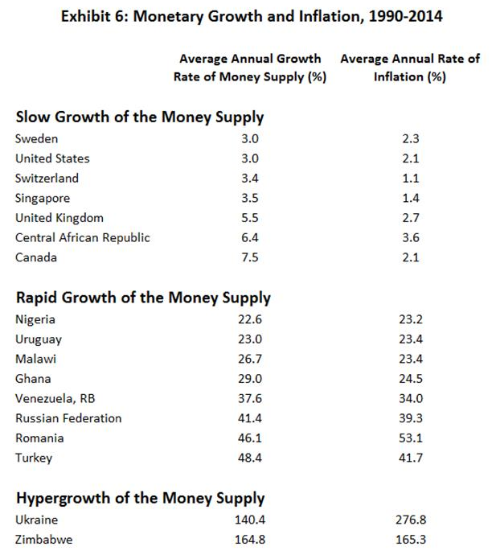
The Linkages Between Various Rates of Growth of the Money Supply and Inflation
Inflation is caused by rapid increases in the supply of money.
The evidence presented in exhibit 6 supports this claim.
Source: The World Bank, World Development Indicators, 2015 and International Monetary Fund, International Financial Statistics (annual).

Slide 47
Monetary Policy and Economic Stability
Shifts in monetary policy exert an impact on output and prices with a time lag.
The time lags of monetary policy are variable and sometimes quite lengthy.
Because of these time lags, persistent shifts back and forth from restrictive to expansionary monetary policy are likely to do more harm than good. They are likely to be a source of economic instability.

Slide 48
Monetary Policy and the Great Recession
Expansionary monetary policy during 2002-2004 pushed interest rates to historic low levels.
Along with regulations promoting easy credit for housing, the low interest rates of 2002-2004 generated a boom in housing prices.

Slide 49
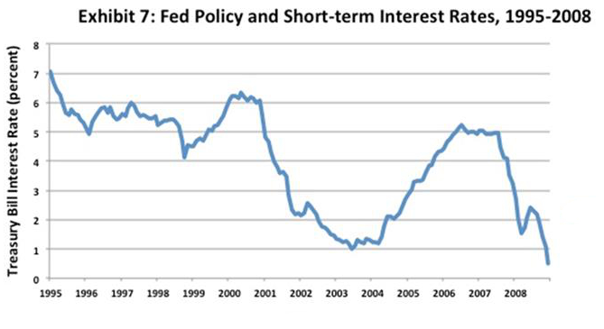
Monetary Policy and the Great Recession Continued…
Period of
Restrictive
Monetary
Policy
Period of
expansionary
monetary
policy
Year
As inflation rose during 2005, the Fed shifted to a more restrictive monetary policy that increased interest rates.
This more restrictive monetary policy reduced home prices, led to higher mortgage default rates, and contributed to the Great Recession.
Source: Federal Reserve System

Slide 50
Module 6: Questions for Thought
Would an increase in the minimum wage be an effective way to reduce the poverty rate? Why or why not?
What is the motivation for occupational licensing? Who is helped and who is hurt by occupational licensing?

Slide 51
Module 6: Questions for Thought
How did the combination of regulations promoting loose mortgage lending standards and the Fed’s artificially low interest rate policies influence the boom and bust in the housing market and the soaring default rates and Great Recession that followed?
How does money of stable value influence the volume of trade? How will this influence economic growth and prosperity?

Slide 52
Module 7: Impact of Taxes and International Trade
CSE Part 2, Elements 6 and 7 plus concluding thoughts
Concepts Covered:
Taxes, incentives, and productive activity
Gains from international trade
Economics, politics, and trade restrictions
Economic freedom, growth, and income

Slide 53
Element 6. Low Tax Rates: People produce more when they can keep more of what they earn.
Taxes are paid in the sweat of every man who labors. If those taxes are excessive, they are reflected in idle factories, in tax-sold farms, and in hordes of hungry people tramping streets and seeking jobs in vain.
—Franklin D. Roosevelt,
Pittsburgh, October 19, 1932

Slide 54
Marginal Tax Rates and Incentive to Earn
The marginal tax rate is the additional tax liability divided by addition income.
It is important because it determines the share of additional income the taxpayer is permitted to keep.
High marginal tax rates:
discourage work effort and reduce the productivity of labor.
reduce both the level and efficiency of capital formation.
encourage individuals to consume tax-deductible goods when nondeductible goods may actually be more desirable.

Slide 55
Major Tax Reductions: Historical Examples
Reductions in tax rates, particularly high rates, can increase the incentive to earn and improve the efficiency of resource use.
The United States has had three major reductions in tax rates:
the rate reductions during the 1920s in the aftermath of World War I
the Kennedy tax cuts of the 1960s
the Reagan tax cuts of the 1980s
All were followed by strong and lengthy expansions in real output.

Slide 56
Tax Policy and the Great Depression
Large tax increases can exert a disastrous impact on the economy.
A large personal income tax increase was adopted in 1932 in the midst of the Great Depression.
The top marginal rate was increased from 25 percent to 63 percent in 1932. Other income tax rates were increased by a similar proportion.
The results were disastrous. In 1932, real output fell by 13 percent, the largest single-year decline during the Great Depression era. Unemployment rose from 15.9 percent in 1931 to 23.6 percent in 1932.
In 1936, the Roosevelt Administration increased the top marginal rate to 79 percent. Recession and rising unemployment also followed this tax increase.

Slide 57
High Implicit Marginal Tax Rates
Many people with relatively low incomes often confront high implicit marginal tax rates once the combination of additional taxes and the loss of transfer benefits is considered.
These high marginal tax rates substantially reduce the incentive to earn and make it more difficult for many to move up the income ladder.
These high implicit rates also reduce productive activity, impede both employment and investment, and promote wasteful use of resources.

Slide 58
Element 7. Free Trade: people achieve higher incomes when they are free to trade with people in other countries.
Free trade consists simply in letting people buy and sell as they want to buy and sell. Protective tariffs are as much applications of force as are blockading squadrons, and their objective is the same—to prevent trade. The difference between the two is that blockading squadrons are a means whereby nations seek to prevent their enemies from trading; protective tariffs are a means whereby nations attempt to prevent their own people from trading.
—Henry George

Slide 59
Key principle of International Trade
A nation progresses by selling goods and services that it can produce at a relatively low cost and trading for those that would be costly to produce domestically.
Exchange makes it possible for both trading partners to expand their production and consumption.

Slide 60
Gains from International Trade
There are three major sources of gains from trade. International trade:
benefits people when they can acquire a product or service through trade more cheaply than they can produce it domestically.
allows domestic producers and consumers to benefit from economies of scale.
promotes competition in domestic markets and allows consumers to purchase a wider variety of goods at lower prices.

Slide 61
Government Barriers to Trade
Trade barriers include tariffs on imports, domestic subsidies, quotas on imports, bureaucratic red tape, etc.
Trade barriers create inefficiencies in the protected industries, raise the cost of doing business with those protected industries, and force domestic consumers to pay higher prices than would be the case with free trade.
Trade barriers neither create nor destroy domestic jobs; they merely reshuffle employment.

Slide 62
The Link Between Imports and Exports
Trade restrictions that reduce imports will also reduce the ability of foreigners to buy our exports.
Quotas and tariffs decrease the number of dollars earned by foreigners through the sale of imports to us.
Therefore, reductions in imports simultaneously reduce exports.

Slide 63
Is the United States a free trade country?
Many Americans think the U.S. practices free trade, but that is not entirely true.
The U.S. imposes tariffs of 10 percent or higher on more than 1,000 product categories, including footwear and apparel.
The U.S. also imposes quotas on dairy products, sugar, ethanol, cotton, beef, canned tuna, and tobacco.
Further, procedures imposed in the aftermath of September 11, 2001, have made it both more costly and time-consuming to clear goods through customs.

Slide 64
Globalization and Poverty
Lower transportation costs and reductions in trade barriers have substantially increased the volume of international trade during the past three decades.
The reduction in trade barriers has been most pronounced in low-income countries. Beginning in the 1980s, numerous less-developed countries including China and India lowered their tariffs, relaxed exchange rate controls, and removed other trade barriers.

Slide 65
Globalization and Poverty continued…
The growth of international trade has made it possible for the world to produce a larger output and achieve a higher level of consumption than otherwise would have been the case. The poor in particular have benefited from the freer trade, and worldwide, nearly a billion people moved out of extreme poverty in the 20 years from 1990 to 2010.
Further, the growth of international trade has narrowed the income gap between rich and poor nations. Less-developed countries have grown more rapidly than high-income developed nations. The distribution of income worldwide is now more equal than it was in 1980.

Slide 66
Motivation for Trade Barriers: Earnings Inequality
Motivation for Trade Barriers
In high-income countries, trade openness may increase earnings inequality. These countries tend to export goods requiring lots of high-skill, well-educated labor while disproportionately importing goods produced by low-skill labor. This contributes to earnings inequality and generates hostility toward international trade.

Slide 67
Motivation for Trade Barriers: Special Interest Politics
Special interest politics also generates demand for trade restrictions.
Trade restrictions benefit producers and workers in specific industries at the expense of consumers. The gains of the industries lobbying for the trade restrictions are visible and concentrated, while the consumers are poorly organized and the costs imposed on them are widely dispersed. Predictably, the special interests will have more political clout, providing politicians with a strong incentive to cater to their views.
History demonstrates the danger of trade barriers. Hostility toward trade in 1930 led to the passage of the notorious Smoot-Hawley trade bill.

Slide 68
The Smoot-Hawley Trade Bill of 1930
The bill increased tariffs on more than 3200 goods by approximately 50 percent.
The volume of trade declined sharply.
The economy fell deeper into recession and the unemployment rate soared.
Unemployment stood at 7.8 percent when the Smoot-Hawley bill was passed, but it ballooned to 23.6 percent of the labor force just two years later.
The stock market, which had been above 280 at passage, fell below 90 in the two years following its passage.

Slide 69
Economic Freedom, Growth, and Income
The seven elements of this section imply that institutions and policies supportive of economic freedom will generate more rapid growth and lead to higher income levels. Is this really true?

Slide 70
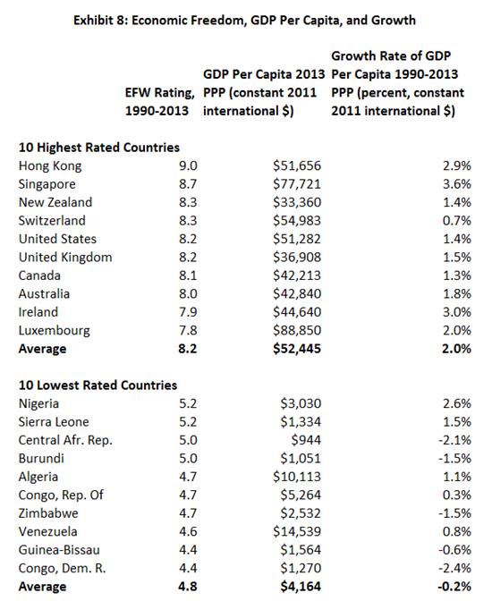
The countries with the highest levels of economic freedom have the highest per capita GDP and growth rates.
Source: Derived from World Bank, World Development Indicators and James Gwartney and Robert Lawson, Economic Freedom of the World: 2015 Annual Report.

Slide 71
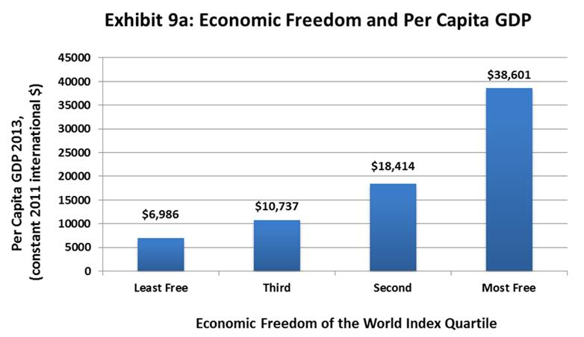
Average per capita income in the most free countries is nearly six times that of the least free countries.
Source: Fraser Institute, Economic Freedom of the World: 2015 Annual Report

Slide 72
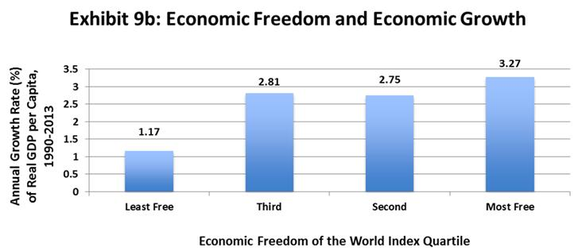
Economic growth leads to high levels of per capita income. Therefore, the higher rates of growth for the most free countries in this exhibit is not surprising
Sources: Fraser Institute, Economic Freedom of the World: 2015 Annual Report, World Development Indicators

Slide 73
Economic Institutions and Prosperity
Countries with institutional arrangements that follow policies consistent with the seven sources of economic growth, grow more rapidly and achieve higher income levels.
When low-income countries get the institutions and policies right, they are able to achieve exceedingly high growth rates and narrow the income gap relative to high-income industrial nations.
This is a major contributing factor to the sharp reduction in poverty since 1980. In 2005, the world’s extreme poverty rate was 25 percent, down from 58 percent in 1980.

Slide 74
Module 7: Questions for Thought
Why are the implicit marginal tax rates (including both taxes owed and loss of transfer benefits) of those with relatively low incomes so high? How does this influence income mobility in the United States?
How have the barriers to international trade changed during the past three decades? What impact have these changes had on the income levels of poor nations relative to those with higher incomes?

Slide 75
Module 7: Questions for Thought
What was the central message of Part II of Common Sense Economics? Is this view correct? Is it widely understood by Americans?

